Slide 1
Deep Learning-Based Gun Detection and Notification System for Law Enforcement.
By -Team 12
Nimisha Chunduru, Sai Kolluri, Sanmukh Venkat Sai Nekkenti, Srinivas Gowtham Majeti, Susanth Ghanta, Tharakanath Chowdary Velaga, Trishank Varma Kothapalli, Vijayeshwari Palakurthi

Slide 2
PROBLEM
In today's world, Law enforcement agencies face the challenge of manually monitoring surveillance footage for gun detection, which is time-consuming and prone to errors. This approach can lead to delays in identifying and responding to firearms incidents.
Therefore, there is a need for an automated gun detection system to enhance public safety and enable timely responses to potential threats.

Slide 3
OBJECTIVE
The objective of this project is to create a system that can quickly and accurately detect Guns from live-streaming video and notify law enforcement via Gmail with a gun-detected captured image and location.
This can enable law enforcement agencies to quickly detect potential threats, respond proactively, and take appropriate action to prevent gun-related incidents.

Slide 4
IMPLEMENTATION
A deep learning-based gun detection and notification system for law enforcement implementation involve the following steps:
1. Collect diverse gun images.
2. Train a deep-learning gun detection model.
3. Set up live video streaming with a camera.
4. Process frames in real-time to detect guns.
5. Retrieve the camera-captured image and location.
6. Integrate Gmail’s SMTP for email sending.
7. Send email notifications to law enforcement with gun images and locations.

Slide 5
WORKING
The system we developed has a web camera, and it live stream video as an input to the system if the system detects the gun the web camera captures the image and current location and triggers an instant notification to law enforcement via Gmail.

Slide 6
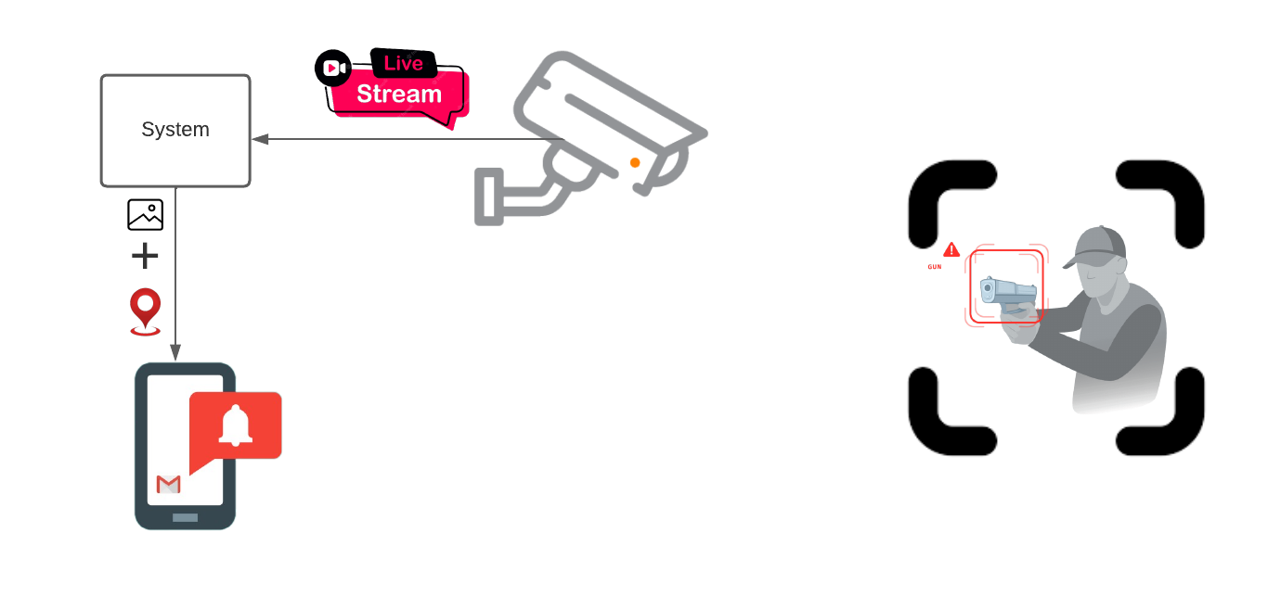
WORKFLOW

Slide 7
APPLICATIONS:
Implementing the gun detection system in educational institutions can help safeguard students and faculty by promptly detecting firearms on campus and notifying authorities to take immediate action.
The gun detection system can be utilized to monitor and secure restricted areas, such as government buildings, airports, and critical infrastructure sites, to prevent unauthorized access to firearms.

Slide 8
CONCLUSION
A deep learning-based gun detection and notification system for law enforcement use advanced algorithms to detect guns in real-time surveillance footage. By training a deep learning model with a diverse dataset of gun images, the system can identify the presence of guns and generate alerts for law enforcement via Gmail attached to gun-detected images and location. This technology enhances public safety and response to potential threats.

Slide 9
Thank you

